Slide 1
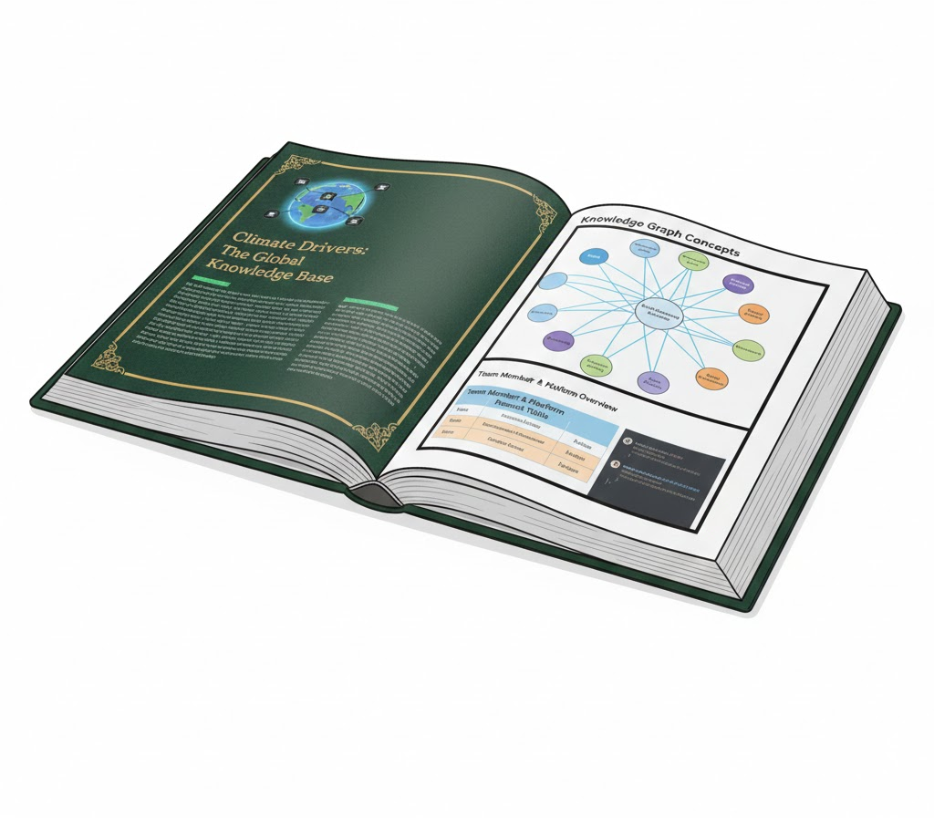
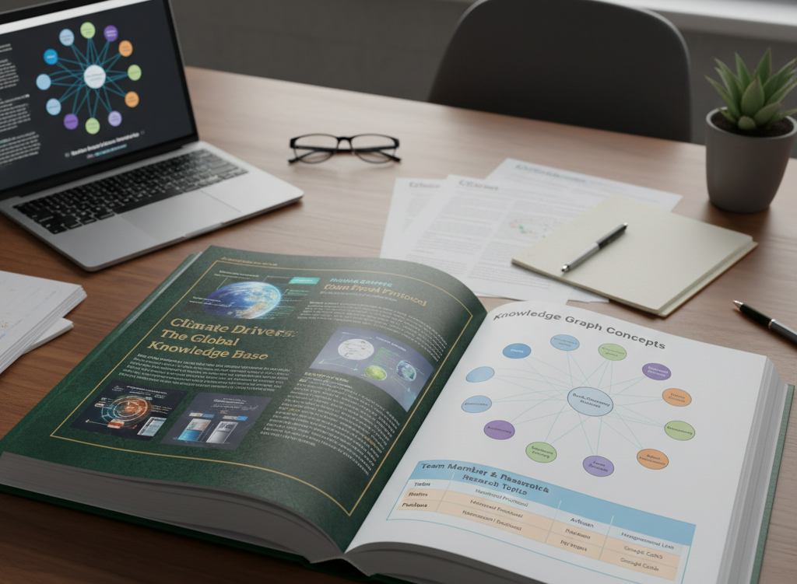
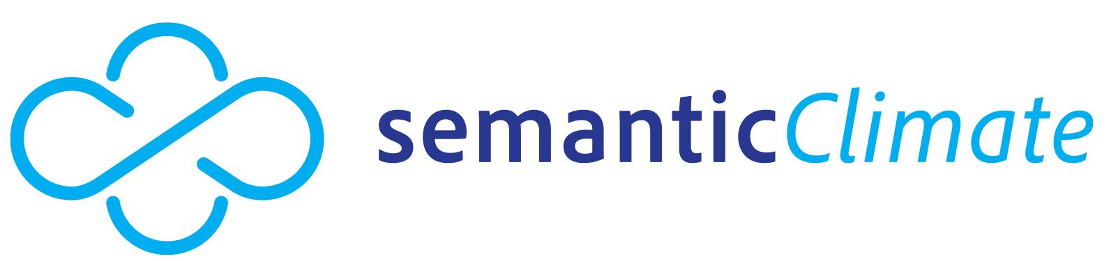
ENCYCLOPEDIA
Presented by- Taiba Shamim

Slide 2
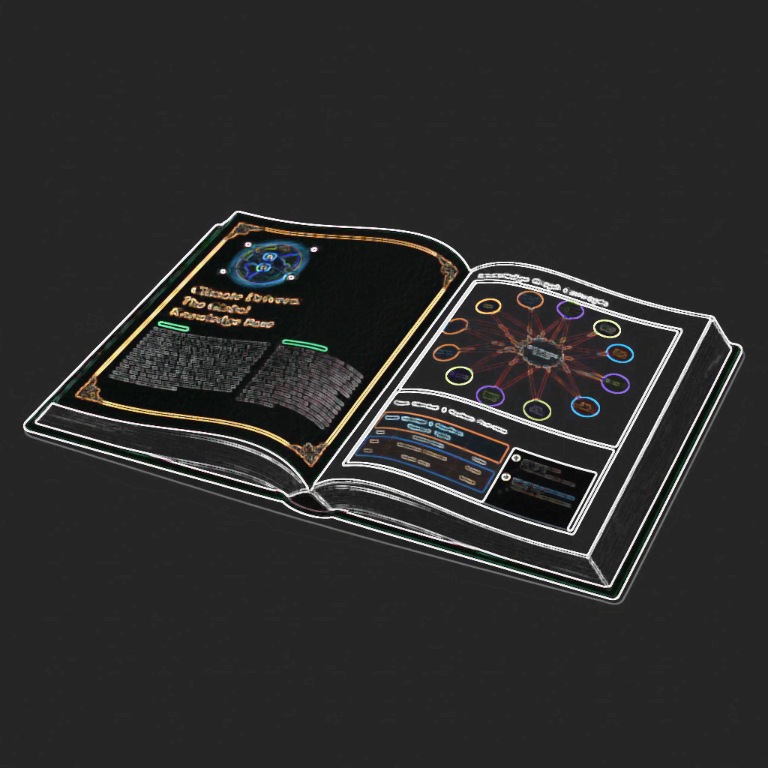
Topic – Montreal Protocol

Slide 3

Team Members
Taiba- Montreal Protocol (Linux Command Line)
Sakshi- Metagenomics of Lantana Camara (Google Colab)
Arhaan- Chemical ecology of plant insect interactions (Google Colab)
Pushpa- India's zero carbon emission by 2070 (Google Colab)

Slide 4
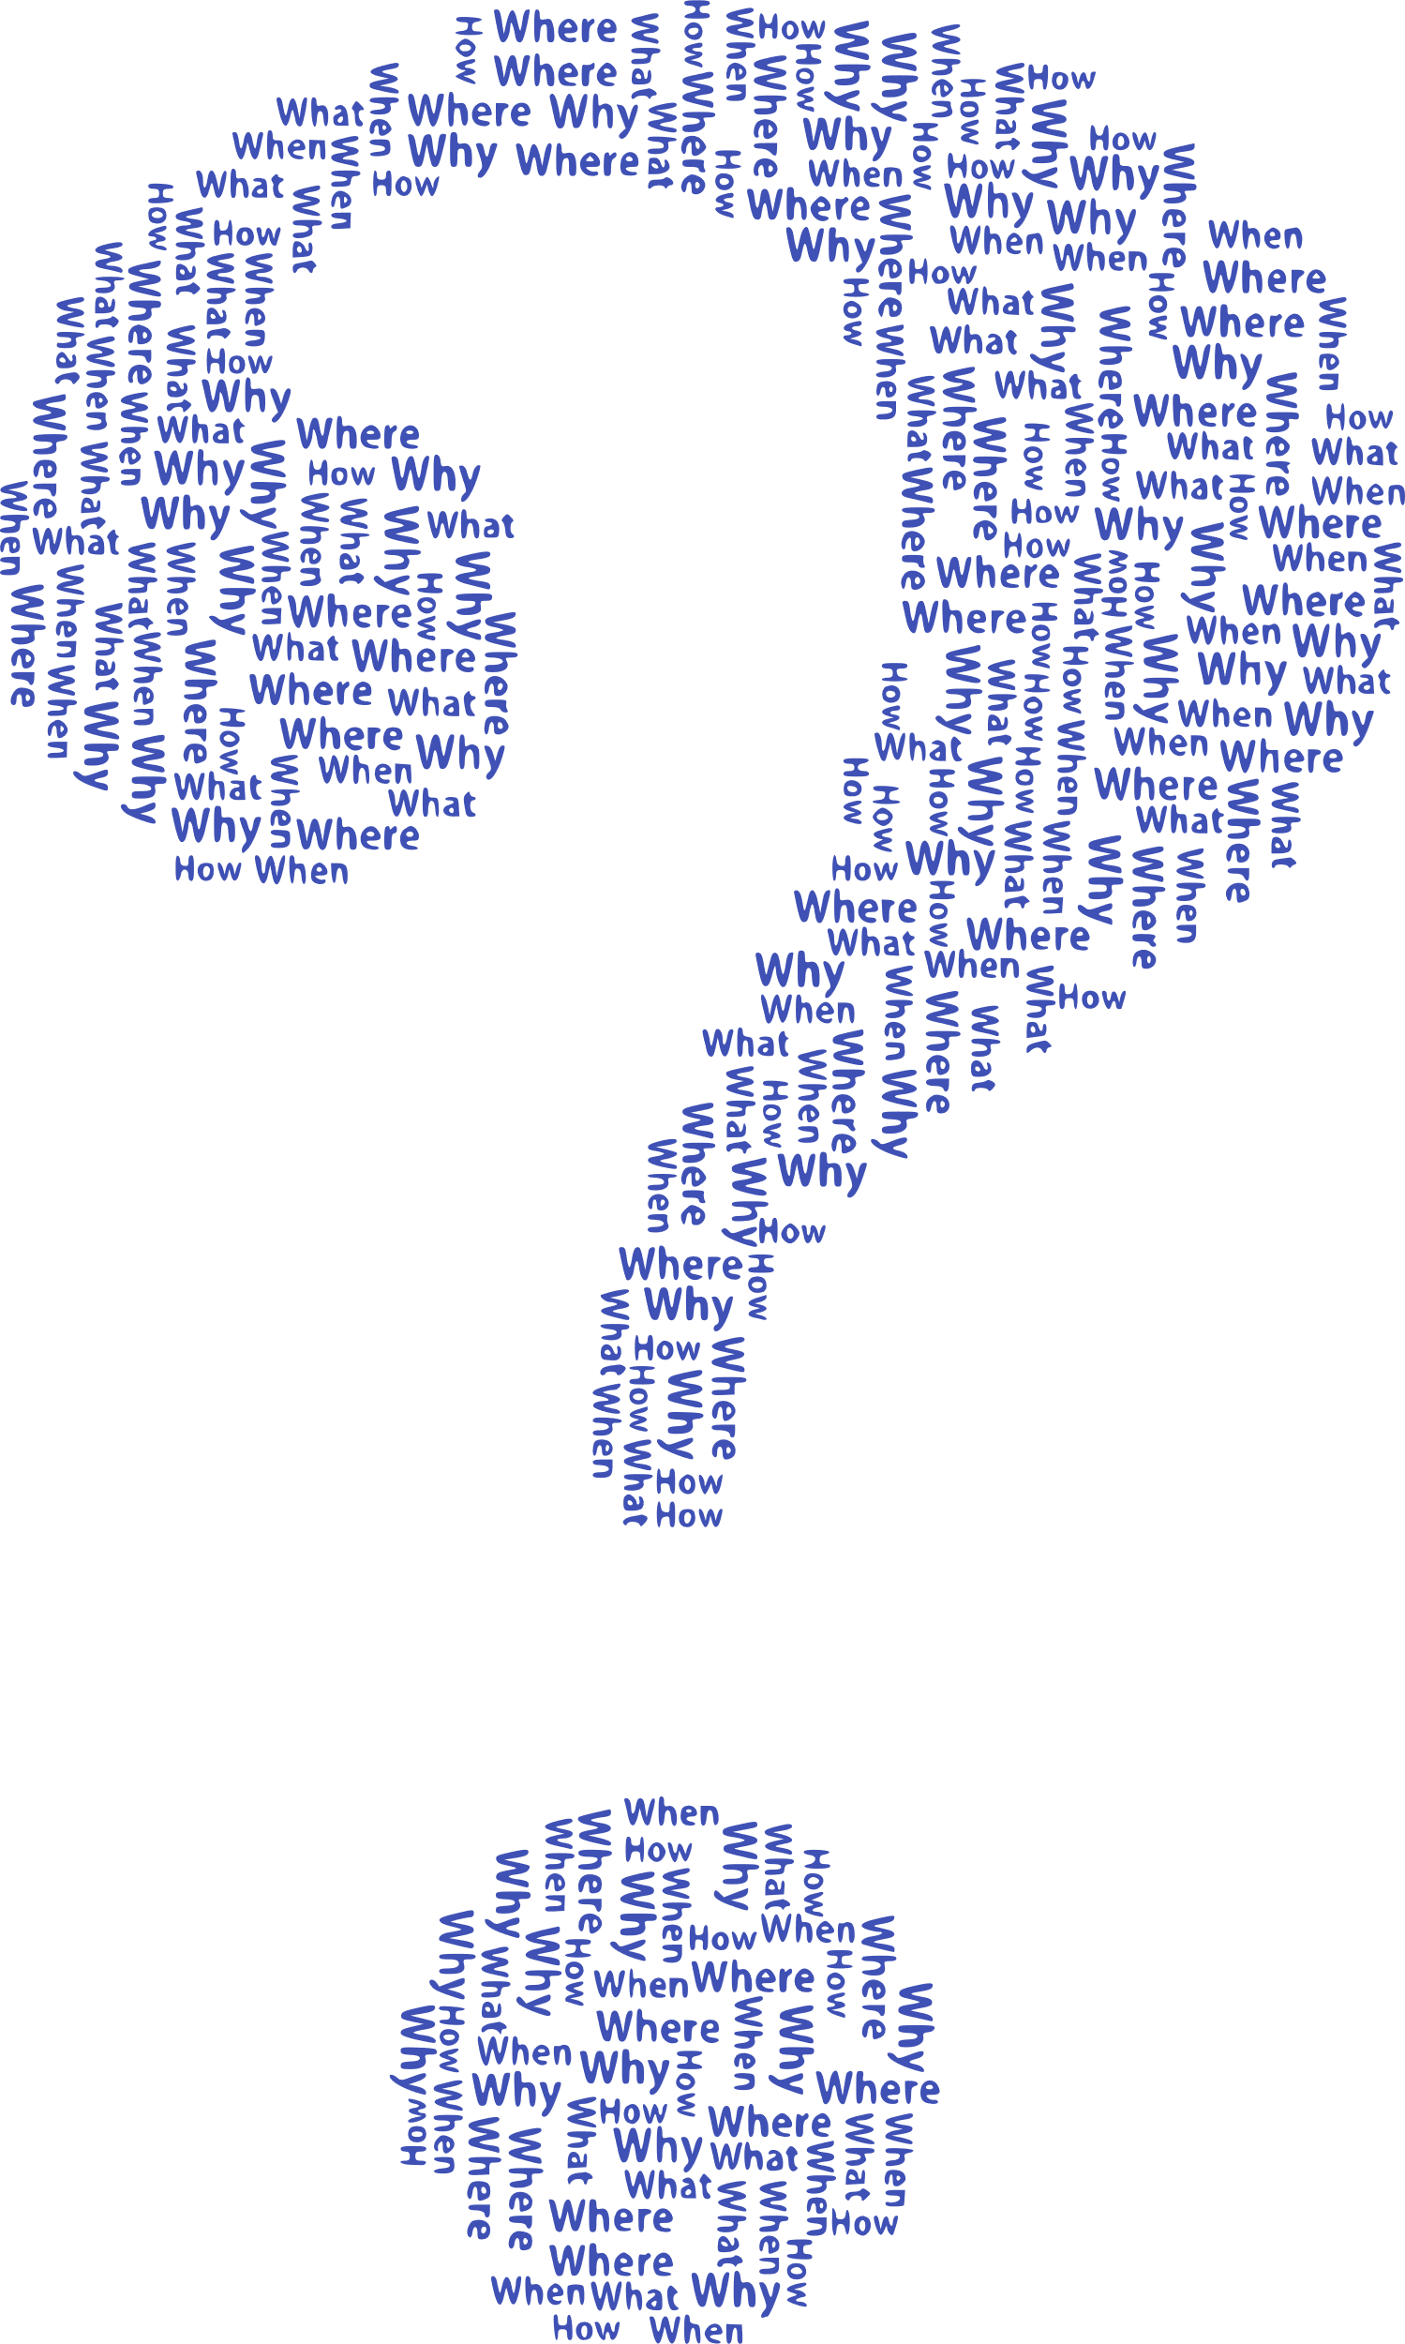
What
A structured encyclopedia generated from scientific climate research papers.
Extracts key terms and connects them through a knowledge graph.
Why
Climate knowledge is scattered in PDFs and difficult to reuse.

Slide 5

Workflow
pygetpapers
version 1.2.5a24
txt2phrases
Version -1.0.3
Remove duplicates from keywords
Using standalone code
amilib
Forms encyclopedia
Version -1.1.2
Knowledge Graph
(Networkx)

Slide 6
Commands used
pygetpapers-
pygetpapers -q "Montreal Protocol" -k 10 -o papers –p
2. txt2phrases
txt2phrases auto -i pygetpapers_output/ -o results/ -n 100
3. amilib
amilib DICT --words /mnt/c/users/workt/desktop/internship_sC/MP-Project/papers/keywords/keywords_cleaned.csv --description wikipedia wiktionary --figures wikipedia --dict /mnt/c/users/workt/desktop/internship_sC/MP-Project/papers/encyclopedia_185.html --operation create

Slide 7
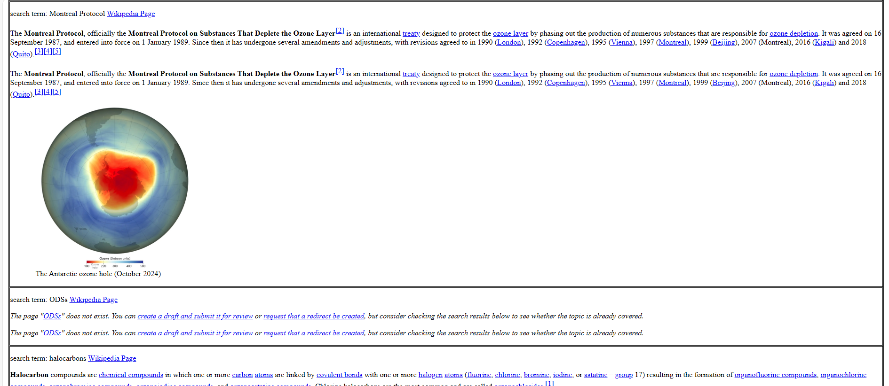
Encyclopedia

Slide 8
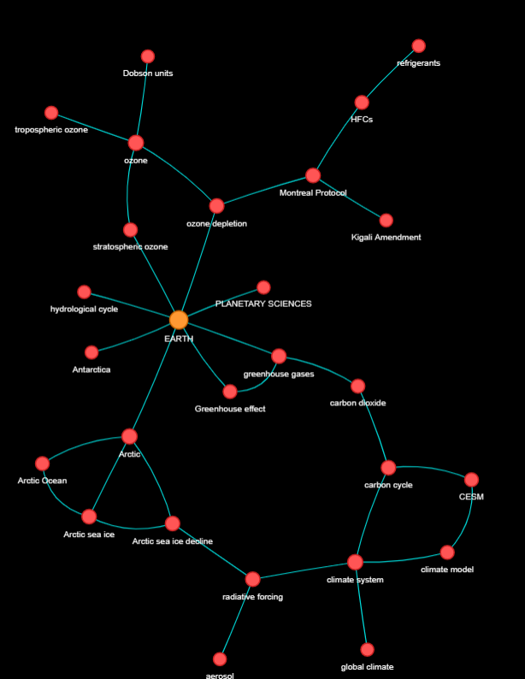
Knowledge Graph

